Slide 1
Network Performance
Dr.Mohammed Abdalla Mahmoud Youssif
1

Slide 2
OUTLINE
PERFORMANCE
Topics Discussed in This Section
Bandwidth
Propagation and Transmission Delay
Exercise 1
Exercise 2
Exercise 3
2
Notes:
2

Slide 3
PERFORMANCE
One important issue in networking is the performance of the network—how good is it? We discuss quality of service, an overall measurement of network performance.
3
Notes:
3

Slide 4
Topics Discussed in This Lecture
Bandwidth - capacity of the system
Throughput - no. of bits that can be pushed through
Latency (Delay) - delay incurred by a bit from start to finish
Bandwidth-Delay Product
4
Notes:
4

Slide 5
Bandwidth
In networking, we use the term bandwidth in two contexts :
The first, bandwidth in hertz, refers to the range of frequencies in a composite signal or the range of frequencies that a channel can pass.
5
Notes:
5

Slide 6
Bandwidth
2. The second, bandwidth in bits per second, refers to the speed of bit transmission in a channel or link. Often referred to as Capacity.
6
Notes:
6

Slide 7
Propagation and Transmission Delay
Propagation speed - speed at which a bit travels though the medium from source to destination.
Transmission speed - the speed at which all the bits in a message arrive at the destination. (difference in arrival time of first and last bit)
7
Notes:
Propagation = نشر
Transmission =نقل
7

Slide 8
Propagation and Transmission Delay
Propagation Delay = Distance/Propagation speed
Transmission Delay = Message size/bandwidth bps
Latency = Propagation delay + Transmission delay + Queueing time + Processing time
8
Notes:
Propagation = نشر
Transmission =نقل
8

Slide 9
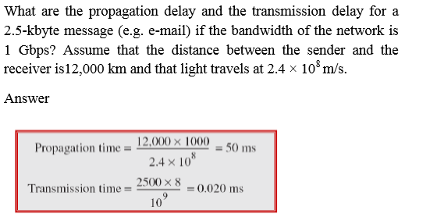
Exercise 1
9
Notes:
9

Slide 10
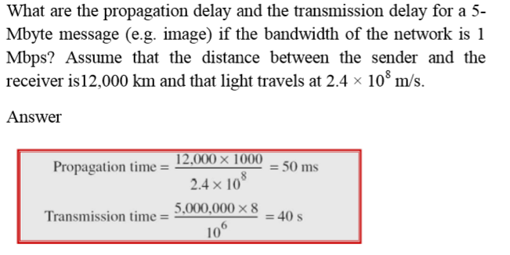
Exercise 2
10
Notes:
10

Slide 11
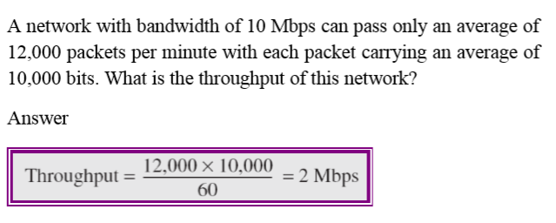
Exercise 3
11
Notes:
11

Slide 12
Questions ?
12
Notes:
12

